Slide 1
Things to do
Highest number of thefts per years
Recovery from stolen
Socioeconomic and demographic
Time parameters
Habit parameters
Find internal relationship
Spatial relationship
Compare part of the results to bike index

Slide 2
The survey was filled out by 2025 participants.
There are 1826 participants who share the theft location

Slide 3
Classification Model
Hierarchical – Start with 5 groups to identify patterns
Find outliers in data
Features redactions
Build 3 models for 3 groups of variables
Bikes
Habits
Socioeconomic Status

Slide 4
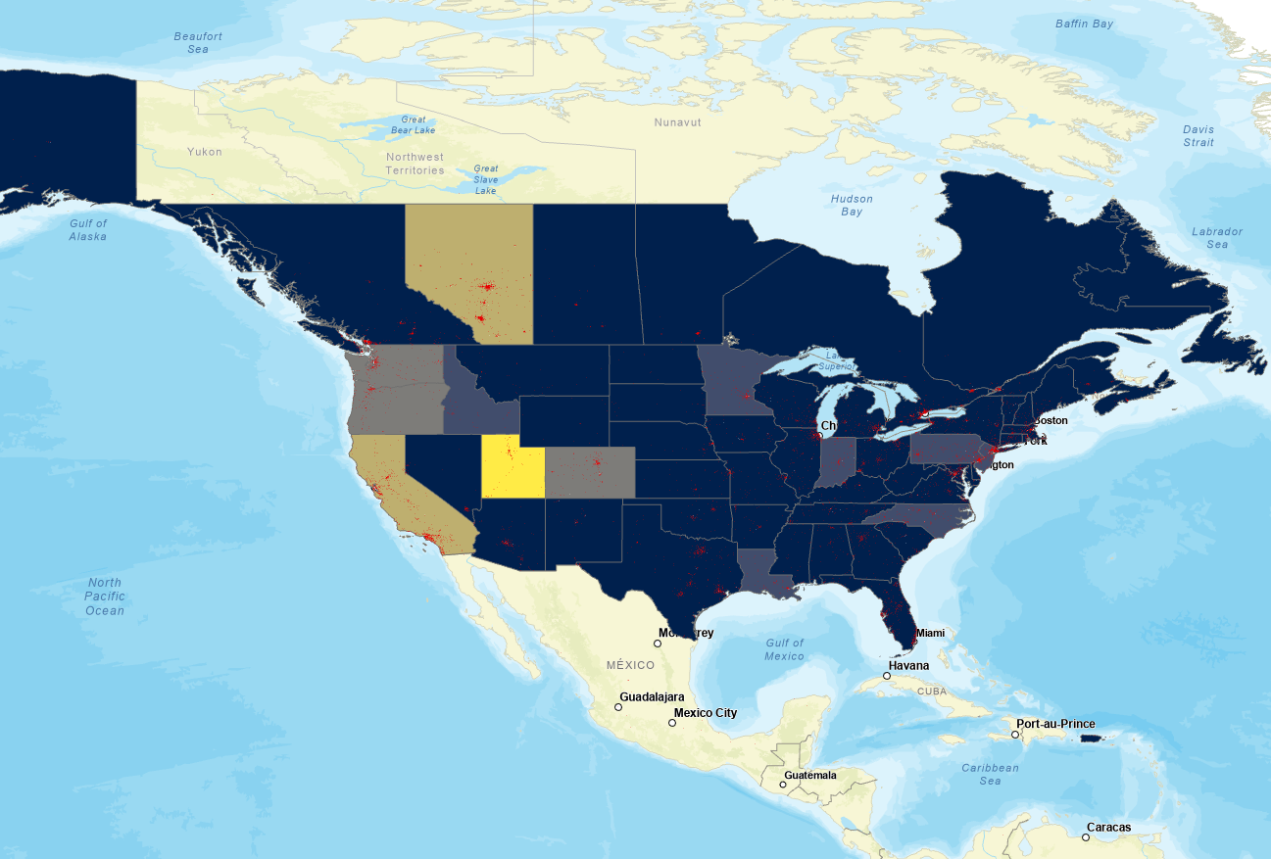
Number of registered bikes by US states and Canada Provinces

Slide 5
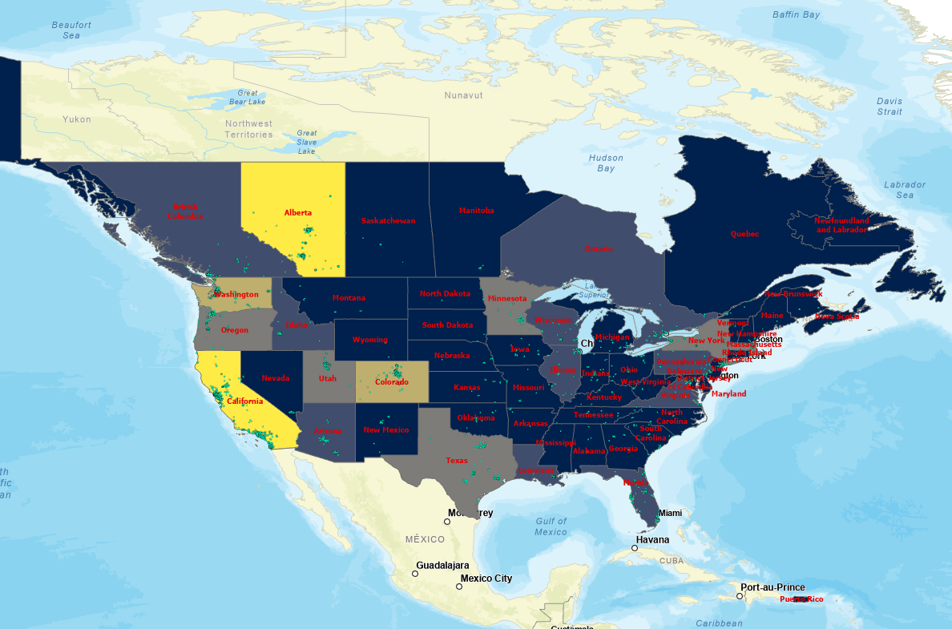
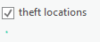
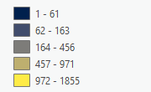
Number of registered bikes’ thefts by US states and Canada Provinces

Slide 6
Per country
Age -
sex
Income
Education
race
per county
Age
sex
Income
Education
race

Slide 7
Important variables
https://www.census.gov/data/developers/data-sets/popest-popproj/popest.html – database to work on
https://www.census.gov/data/developers/data-sets/popest-popproj/popest/popest-vars.html
https://www.census.gov/topics/income-poverty/income/data/tables.2019.List_1734169494.html

Slide 8
Thoughts – Better geocoding
Only places in US and Canada
No geocoding to states /provinces/counties
Separate between the levels of geocoding
Work on regular geocoding
Census data for Canada

Slide 9
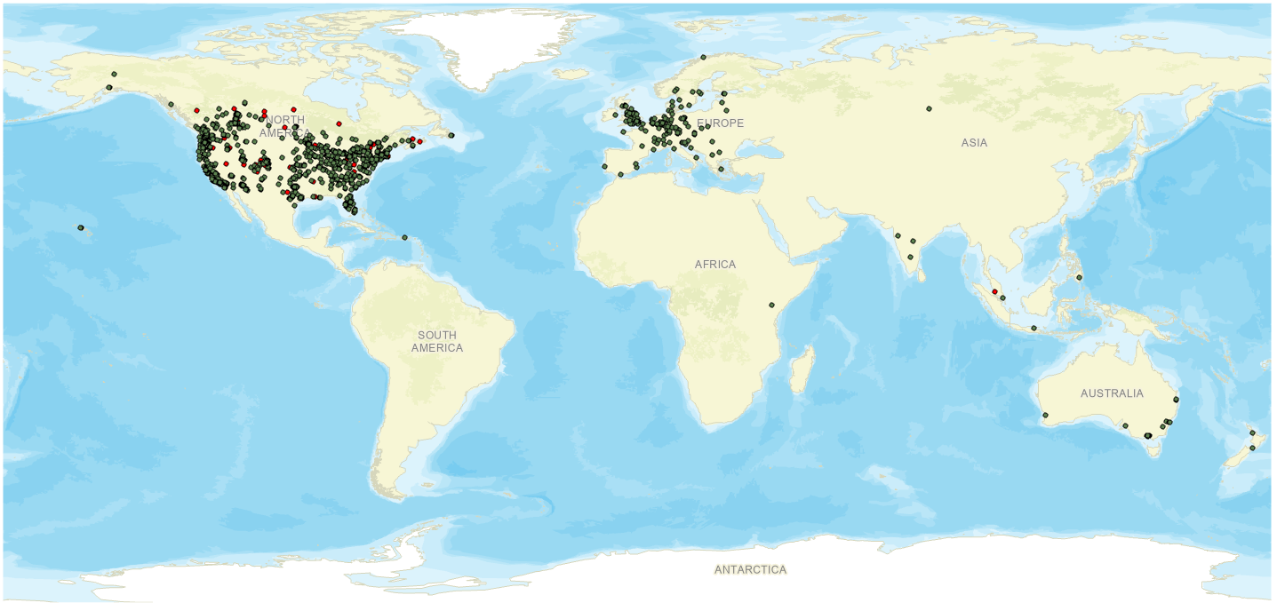
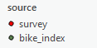

Slide 10
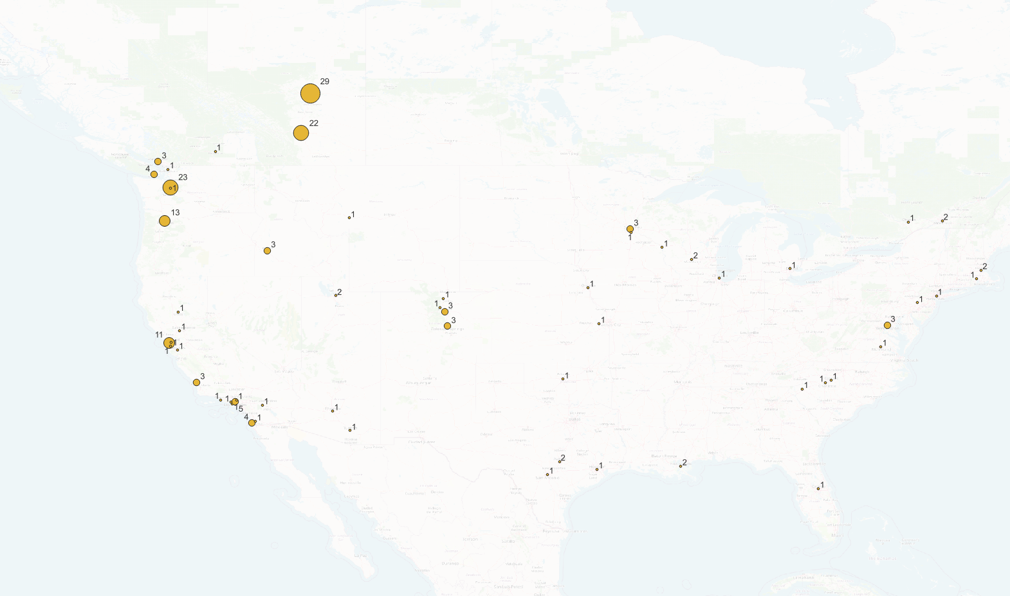

Slide 11
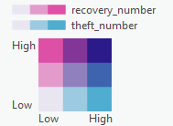
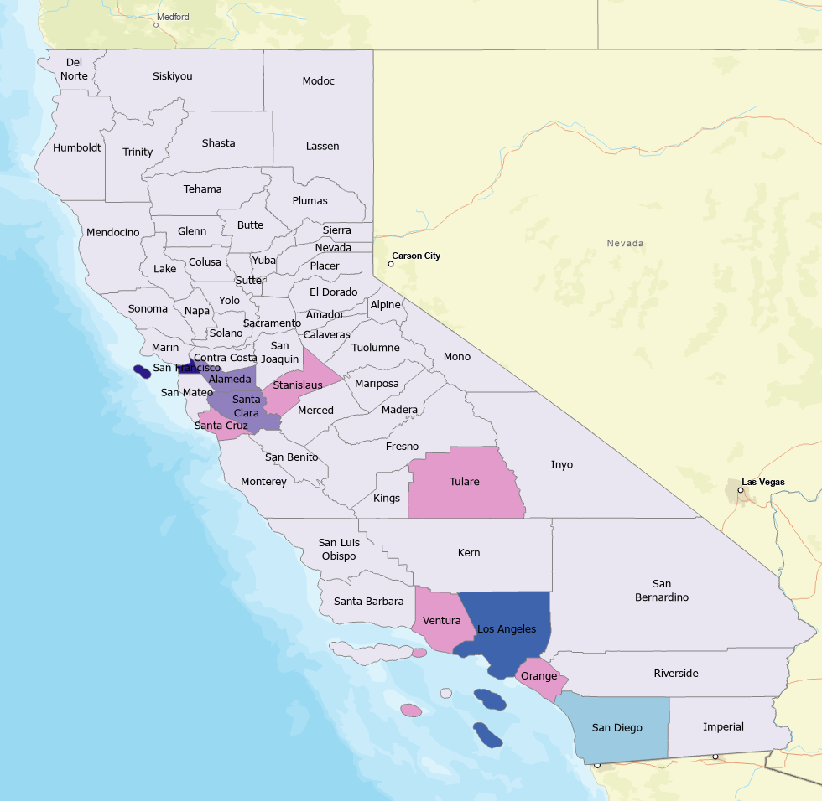

Slide 12
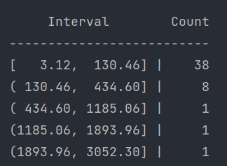

Slide 13
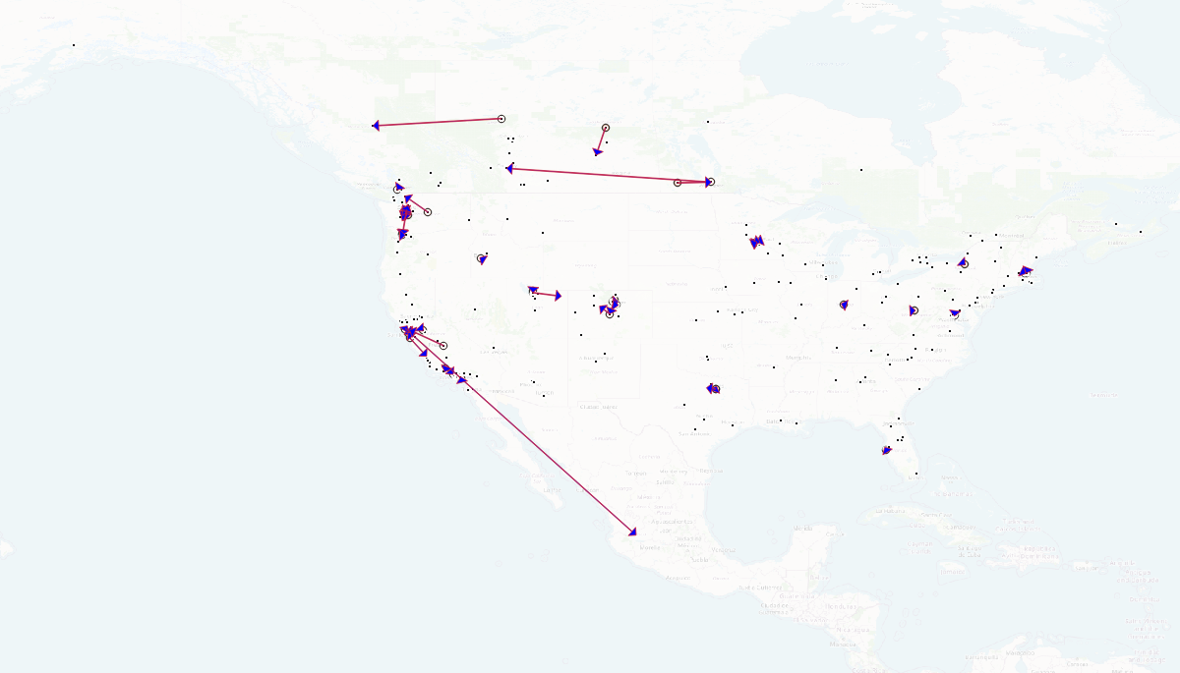
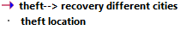

Slide 14
Geo Coding rules
Region
Break it the string
If it is more than 1
Continue
If not
Try convert it to number
If it is work
Put it in postal
If not
Put it in region
If the country name is not Canada or US
Put it into city
IF the score is less than 100 or the country is not Canada or Us
Give warning and return
Create new address

Slide 15
Tasks to do –
Geolocation also for the recovered bikes → Flow map
1. What are the spatial patterns of theft and recovery? 2. What are the (i.e., location, lock type, time of day) that are most often associated with theft.
3.bike index stolen bike locations (10000) - integrate with census data to see if there any social/demographic component to theft

Slide 17
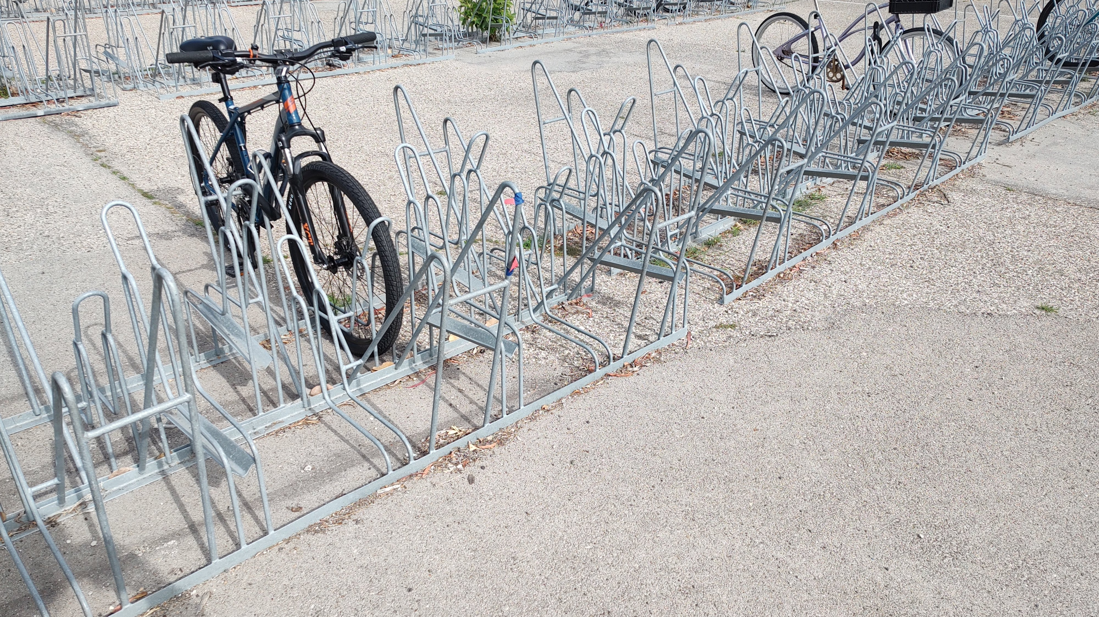
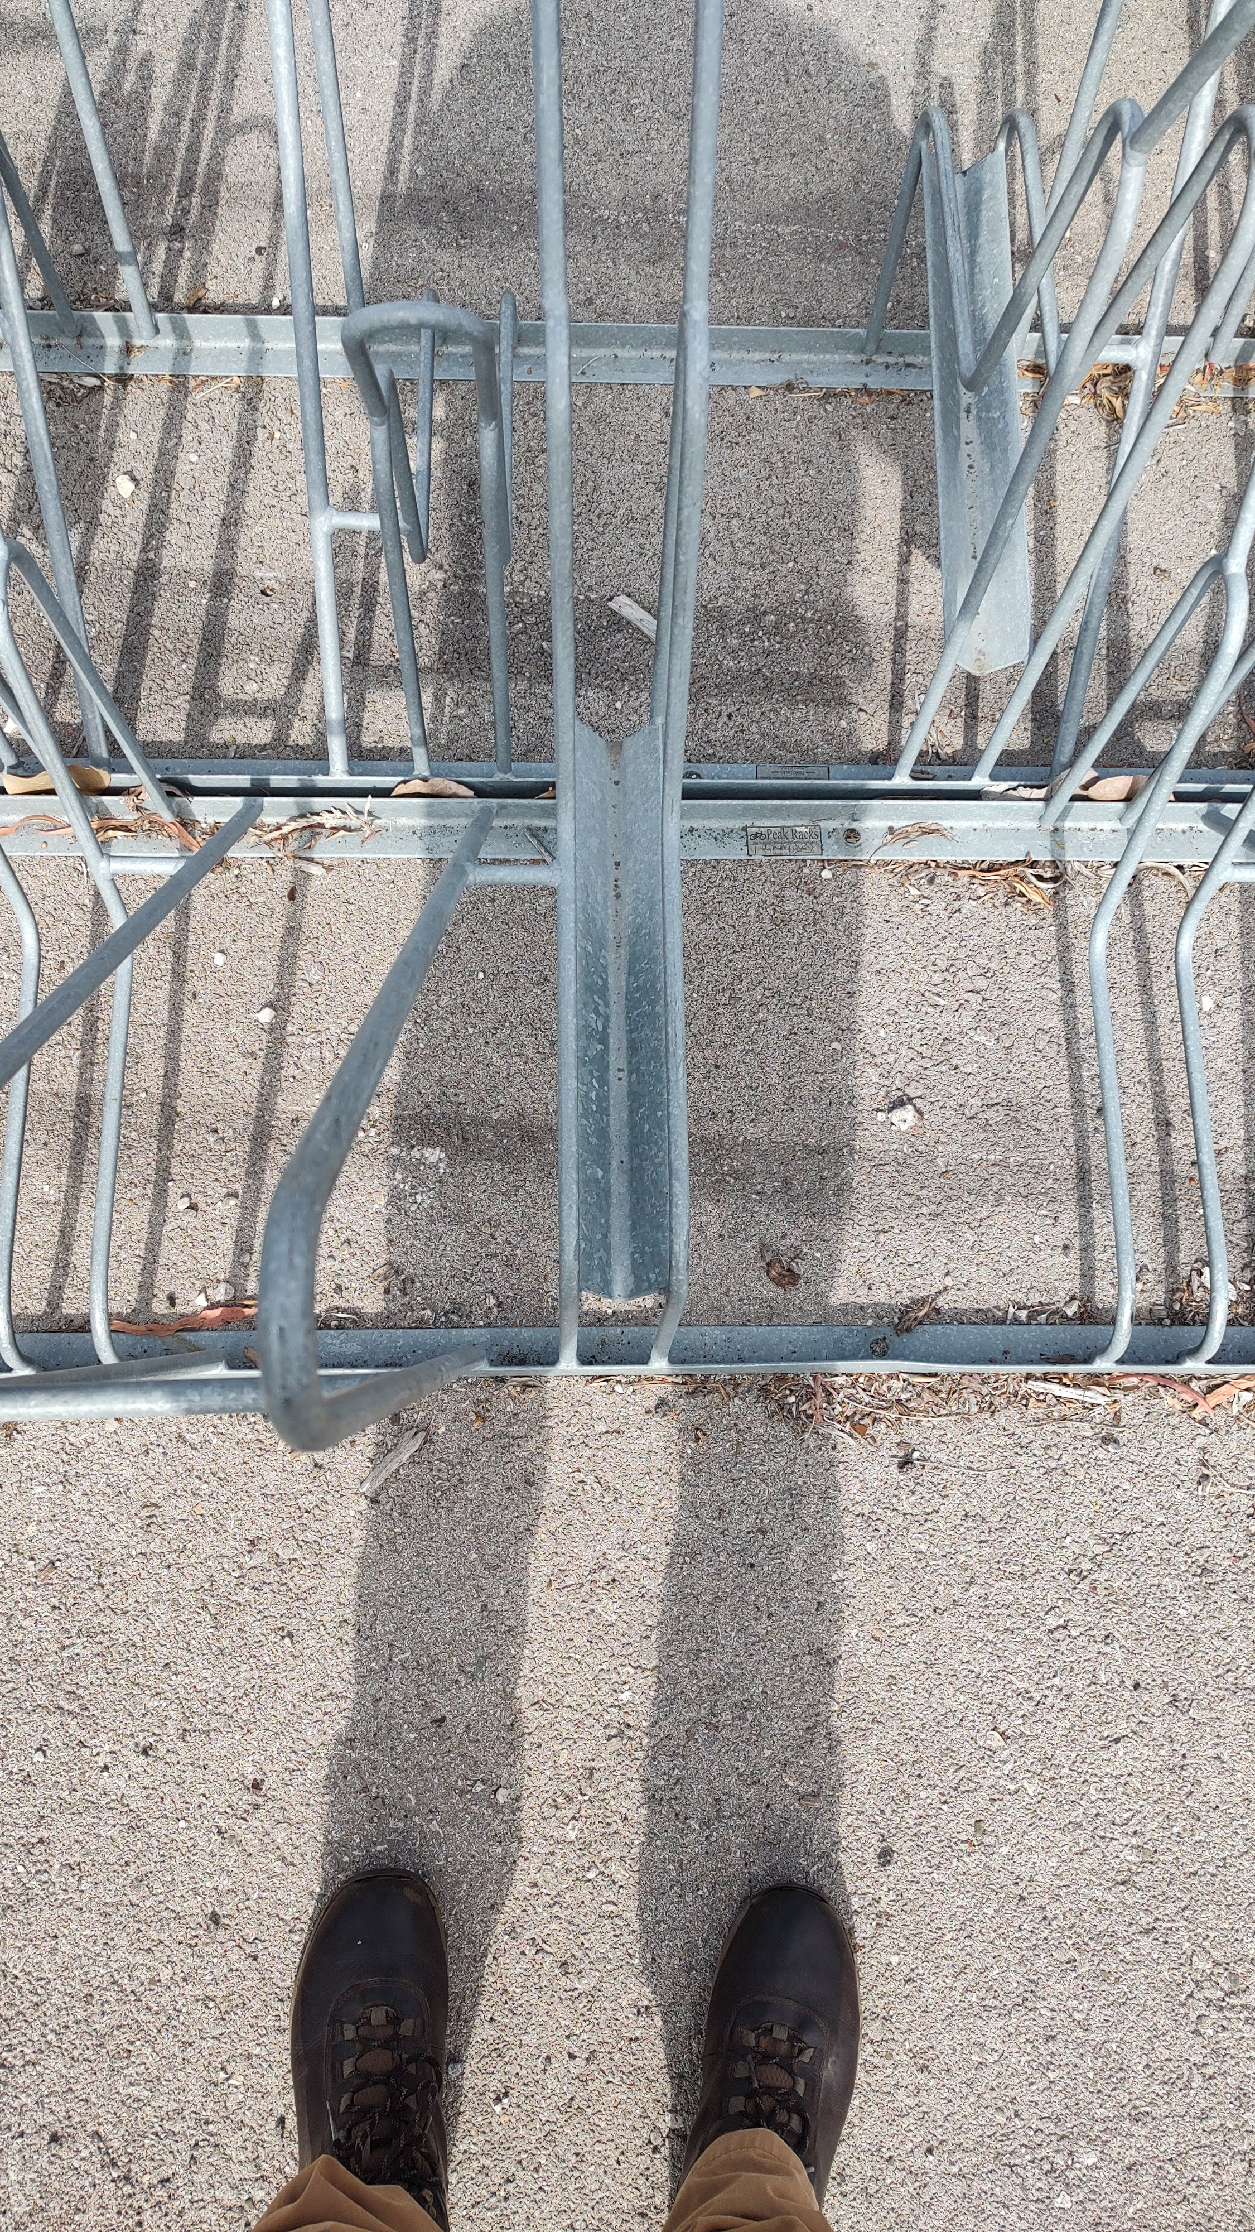
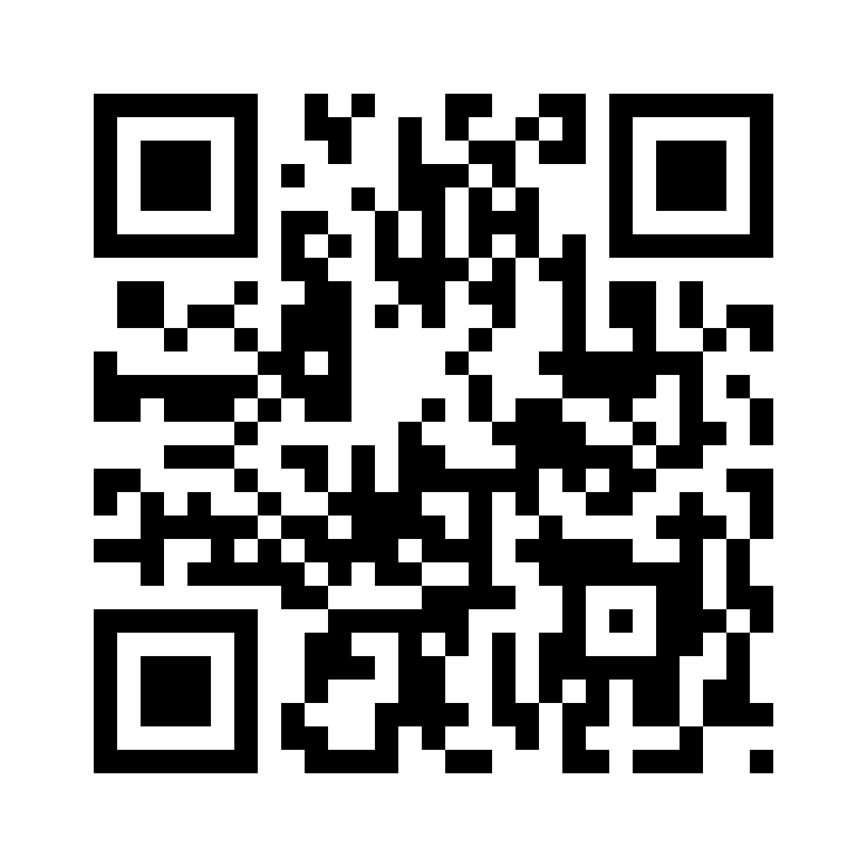
Help us to stop bike thefts by scanning the QR code and completing the survey

Slide 18
Help us to stop bike thefts by scanning the QR code and completing the survey
Help us to stop bike thefts by scanning the QR code and completing the survey
Help us to stop bike thefts by scanning the QR code and completing the survey
Help us to stop bike thefts by scanning the QR code and completing the survey

